Slide 1


Fish!
About
Not About

Slide 2
The Four Key Principles
Choose Your Attitude
  We have the power to choose our attitude, no matter the situation.
  Employees can create a positive or negative environment based on how they choose to engage.
Play
  Infuse fun and creativity into the workday.
  When employees play and enjoy their tasks, morale and productivity increase.
Make Their Day
  Focus on making each customer’s or colleague’s day better.
  Small, meaningful actions can create a big impact.
Be Present
  Engage fully in the moment.
  Giving your full attention to what’s in front of you, whether it’s a customer or a colleague, leads to more meaningful interactions.

Slide 3

Tricks of the Trade
REFRIGERANTS

Slide 4

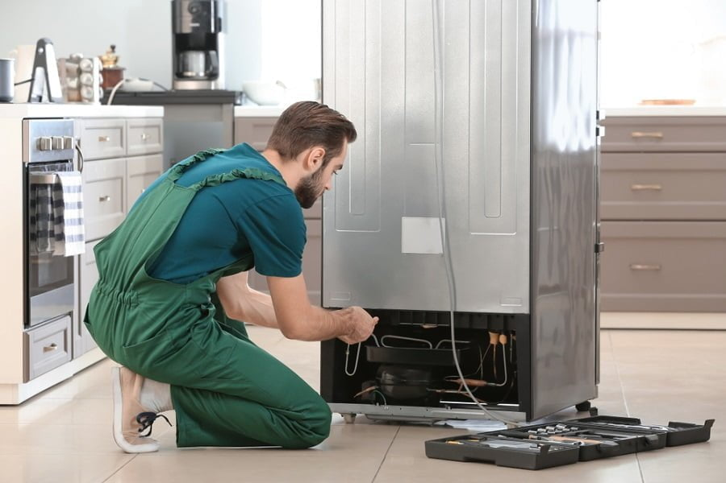

Tricks of the Trade
APPLIANCES

Slide 5

APPLIANCES
Using shoulder dollies is a good trick to prevent accidents causing damage to the appliance and/or yourself.
Working as a team will help be more efficient with time.

Slide 6
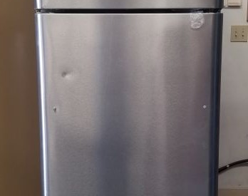
APPLIANCES
When working in a renovation, it is best to install appliances last to prevent damages.

Slide 7
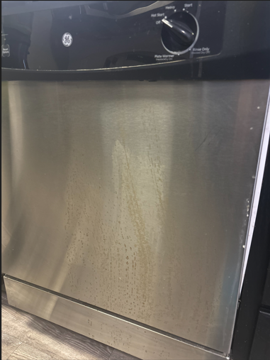
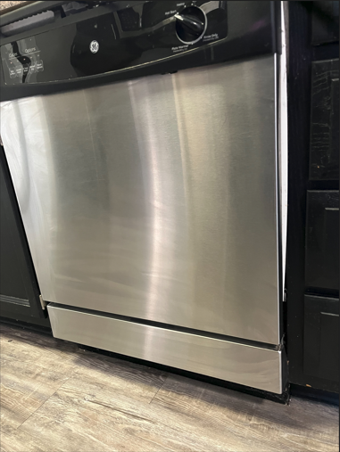
APPLIANCES
Before and after using Barkeeper’s Friend on stainless steel appliances.

Slide 8

APPLIANCES
It is best to replace a timer when called for a bad solenoid. Timer most likely got stuck causing solenoid. This will help prevent parts and labor cost in the end.

Slide 9
APPLIANCES
Dishwashers – on circulation pumps but mostly drain pumps that seize up, you can sometimes bang on them to get them to start working again
Dryer vents can be cleared out with an electric leaf blower
PPE and tie-downs
Surge protector
Ask for help if too heavy
Install them until everything else is finished.
Electric appliance dolly
Use air sled when removing or installing
Always clean refrigerator coils
Dishwashers must always be level
Use barkeepers friend to remove surface rust from stainless steel apps
Ge dishwasher not draining replace drain solenoid as well as timer motor
Shoulder dollies for moving appliances

Slide 10
APPLIANCES
Put together a flyer to be sent out to the residents quarterly and put it in the move in packet on what can go in the disposal, care for appliances, and so forth. Every community may have different items that the residents may need to know. You can always expand on it if you think of more items.
Garbage disposal – have the resident push the reset button first to see if it solves the problem
Use appliance paint to touch up minor scratches
If too warm in the refrigerator, check settings to see if they need adjustments
Dirty Dishwasher - Use citrus kool-aid powder in an empty cycle to remove dishwasher grease and scale.
Oven Temperature Accuracy – Put a small pile of sugar on foil and set the oven to 375 degrees. If it melts, the oven is hot. If it’s solid past 400 degrees, it’s running cool.
Resurfacing stainless steel appliances is cheaper than replacing the stainless surface. Does not remove dents though.
Vinegar helps remove foul odors from sideload washers better than bleach. Bleach is better at removing visible mildew.
Stainless steel sinks that have rust spots or rings you can make a paste out of comet and little water and use a soft sponge and gently rub in circles and it will usually remove it
Using a straight razor blade scrapper will remove the cooked on water/liquids of a glass top stove

Slide 11

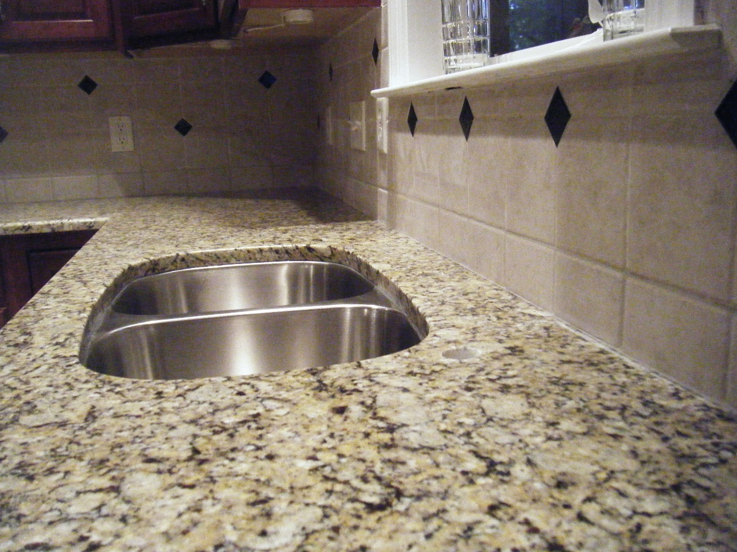
Tricks of the trade
CABINETS/COUNTER TOPS

Slide 12
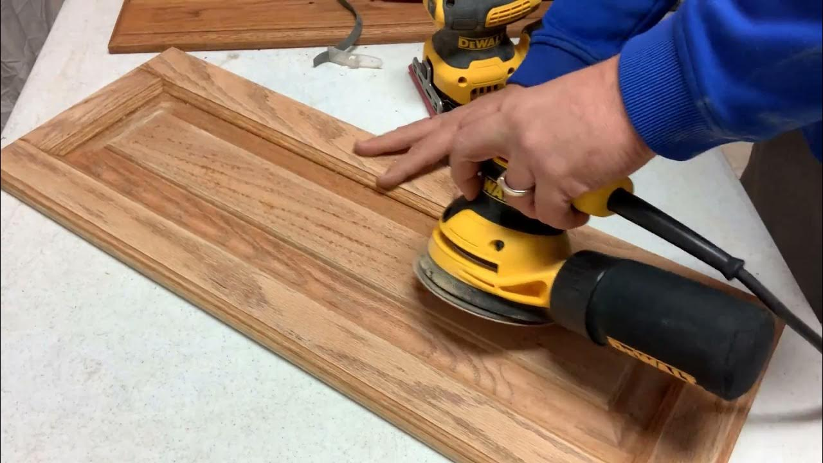

Cabinets/ Counter tops
Always sand and clean cabinets with a degreaser before painting.
Failure to sand and clean cabinets before paint leads to scratches, chips and ware to cabinets. This also means longer turn time when resident moves out or even multiple work orders.

Slide 13
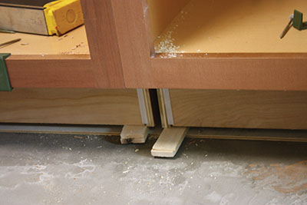
Cabinets and Counter tops
Use shims to ensure cabinets are level.
Always predrill your hose before screwing them to the wall. This helps prevent splitting the wood.
Assemble wall cabinets on the floor then hang them on the wall together.

Slide 14
Cabinets/Counter tops
For removing stains from granite, use a baking soda and vinegar paste. place a good amount on the stain then cover it with saran wrap and tape it down. Leave it for 48 hours. It should help pull the stain out.
Paint in the morning so you can do a second coat in the afternoon
Use the original screws
Lightly sand cabinets before painting
Wall cabinets first – level, cabinet screws, shims
Instead of shims - screw cabinet to wall, place clamp loosen screw, and screw together then tighten screw
Write your map out on the wall before hanging cabinets
Dropping in a glass cutting board on a bad part of the top instead of replacing the entire top
Put cabinets together on the floor, then hang together to ensure they’ll be even
Replace only the portion that is damaged
Light scratches, rub the cabinet with a walnut or almond
Small chip in granite or quartz: Mix super glue with baking soda. Then lightly sand with high grit sandpaper.

Slide 15

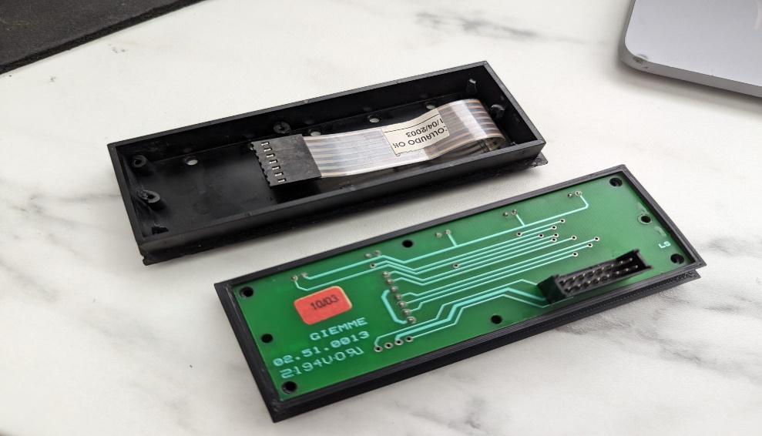
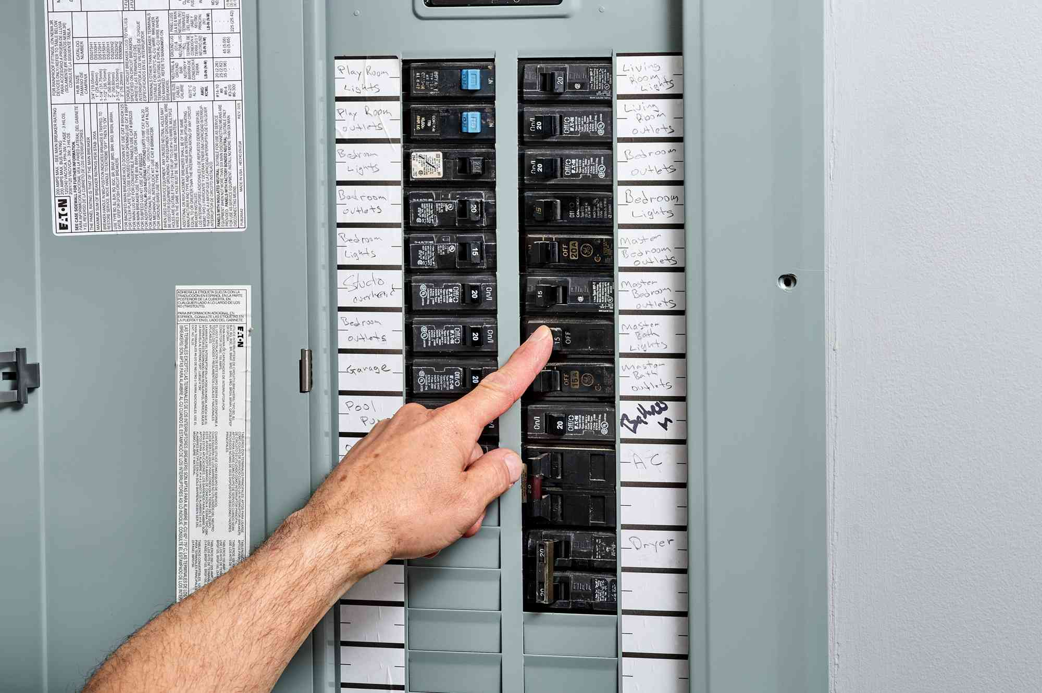
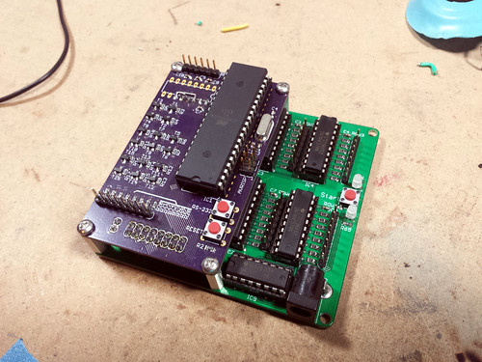
Tricks of the trade
ELECTRICAL

Slide 16

Electrical
It is important to have and use your multi meter when dealing with electricity. Checking the calibration on the meter every couple of months is important and always store it in a case to help prevent damage.

Slide 17
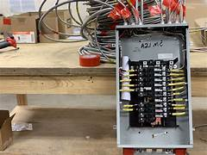

Electrical
Always turn off breakers before service.
It is important to turn breakers off before service to prevent an injury or even a fire. Always check, check, and recheck.

Slide 18
Electrical
Washers locked and won’t open – resetting breaker for a couple of minutes usually fixes this (resets control board)
Same thing for dryers on multiple issues that can occur
Take pictures before moving or disconnecting anything to know how it was hooked up before
Detailed troubleshooting guides for common electrical problems
Have the right tools
Be brave. Se valiente!
Ceiling fan mount, toggle bolts
Trust your meter
Turn off breakers before services
Using remotes for rans instead of running wire
Whenever running wires underground on the exterior, always put it in a sizeable conduit. This way if the wire ever needed to be replaced for some reason, you can connect the new wire to one end and pull it through easily. They make a lube for this as well for long runs
If issues, check to tighten wires in outlet/light switch

Slide 19


Tricks of the trade
GROUNDS

Slide 20
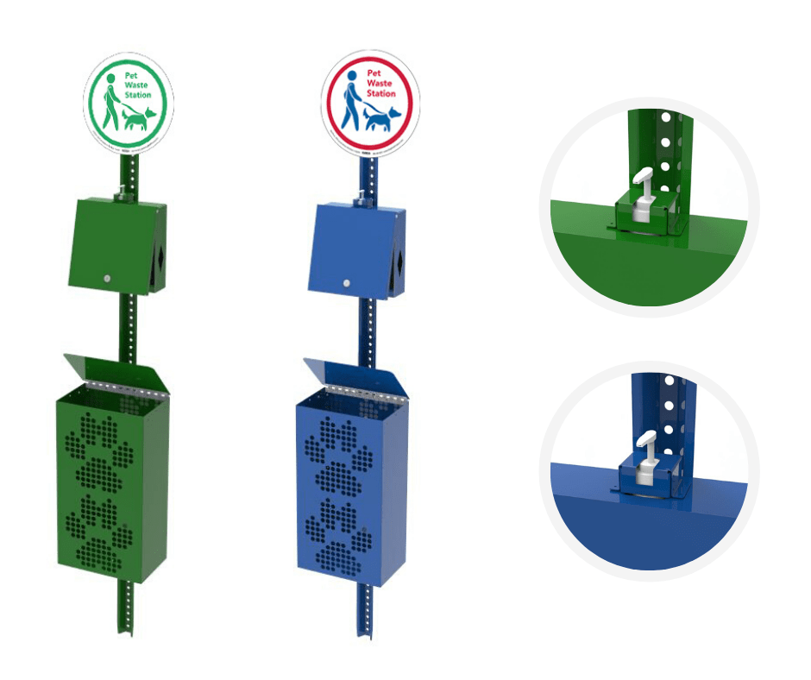
Grounds
Place dog stations strategically around the community to help ensure minimum waste left behind.
Use questionnaire responses to see if there are comments around certain locations that could use one.
While ridding around picking up trash, stop at each station to see if it needs emptied or needs refill on puppy gloves.

Slide 21

Grounds
If possible, keep grabber and bucket on you at all times and pick up trash throughout the day when traveling on the property. This not only helps keep the property looking clean, but will benefit you the next morning while doing grounds. It is also beneficial to keep any trash cans throughout the property (grilling stations, activity centers, etc.) emptied to prevent trash from blowing to the ground.

Slide 22
Grounds
Place dog stations strategically around the community to help ensure minimum waste left behind. Use questionnaire responses to see if there are comments around certain locations that can use one.
Add single dog waste bag dispensers at each breezeway entrance to minimize pet waste in common areas.
Aerate/overseed in fall.
When driving into the community, look at curb appeal as if you were a resident or prospect. Where else can we improve/clean up?
Checklists for opening and closing pools. (BK)
Be checking all the time, submit work orders as needed, and never walk by a piece of trash (F2, TF)
Find a good and efficient routine (F2)
Keep a consistent schedule with a map highlighted of who should be addressing each area daily (WH)
Carry gloves, trash bags, bucket, and grabber on your cart (F2, HP)
Take pictures of resident items that need to get addressed (HP)
Have your groundskeeper check all pop-ups weekly (OV)
Keep all storm drains clear (PF)
Open dumpster lids after they are dumped (PF)
Bald spots in grass. Instead of reseeding, use a mix of compost and sand over the spot. Let nearby grass spread naturally – works faster than seed alone. (WX)
Rotate staff members walking the community to get different sets of eyes on it (TF)

Slide 23

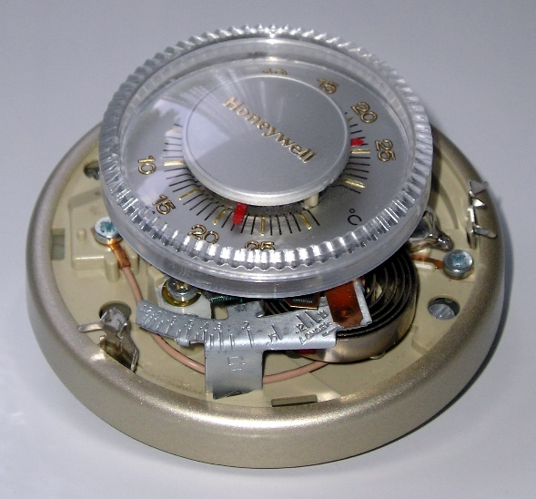
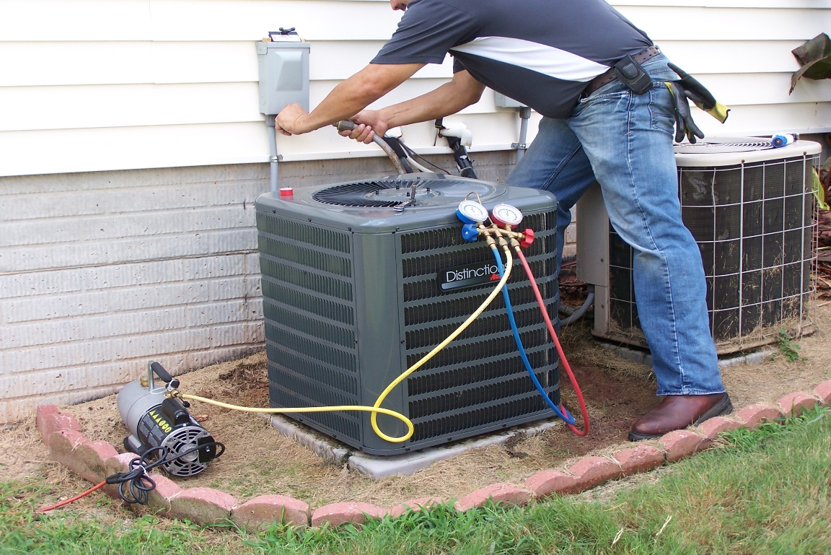
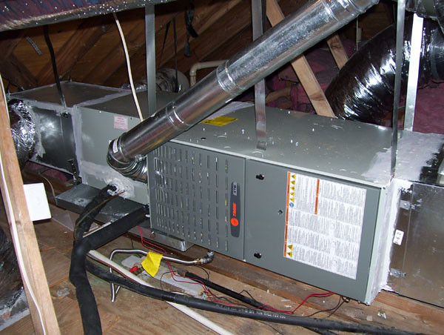
Tricks of the trade
HVAC
This Photo by Unknown Author is licensed under CC BY-SA
This Photo by Unknown Author is licensed under CC BY-SA-NC

Slide 24
HVAC
Advise residents to check heating/cooling prior to peak season to ensure it is working appropriately. This will help prevent several emergency work orders at once as well as overtime.

Slide 25
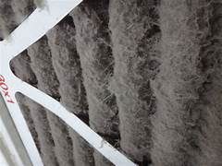
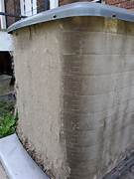
HVAC
Preventive Maintenance
Performing proper preventive maintenance on HVAC systems will prevent systems from over working and limit the amount of emergency calls received.

Slide 26
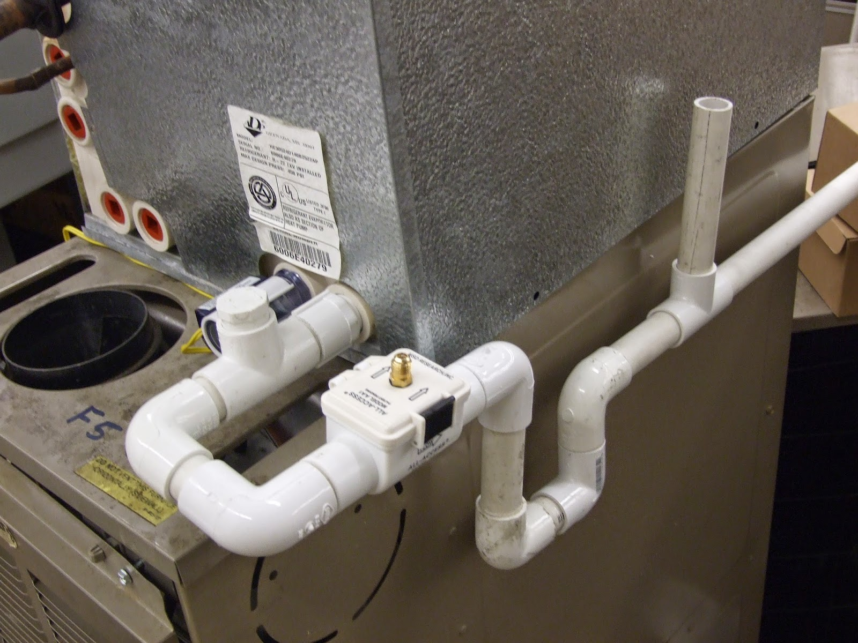
HVAC
Keeping a clean and cleared condensate line will prevent AC calls as well as other damage to home(s). Examples floors, drywall, and residents personal items. When replacing always ensure you have correct pitch and install emergency shut off if there is not one already. If one is present, check it over and make sure it is working properly.

Slide 27
HVAC
Advise residents to check their heating/cooling prior to peak season to ensure it’s working appropriately.
Advise residents if they’re going out of town to not turn off HVAC system but to leave it at a consistent temperature to avoid equipment over-working when turned back on. It’s also more energy efficient.
Checking energy efficiency for both techs and residents
Use a fine wire brush to remove dents from coil fins.
When removing a blower motor from the fan, use sand paper to sand down the top of the shaft to make removal way easier. No banging it out with a hammer!
Change check valve for new one
Bring batteries for thermostat
Check filters and change them as needed outside of PM
Preventative maintenance
Tabs in drain of air handler
Clean coils regularly

Slide 28
HVAC
Use leak stops on problem units
Use sand paper on flame sensors instead of replacing
To boost coolness in the home, keep blinds closed and keep doors open to circulate air
Check power switch and settings with resident before sending maintenance
Pump down a condenser when doing repairs on a unit to save and reuse the refrigerant. Connect the low side hose from the gauges to the low side port on the condenser. Close off the high side valve. Start the unit wait for gauge to pump down to 0 then close off the low side valve then turn unit off.
Checking the T-Stat, use a jumper wire from red to other colors to check each function.
Cleaning the A/C drain line on fur downs in the bathroom ceiling, take off the overflow plate on the tub and suck the condensation drain with a shop vac to clean the line.
Always use a multimeter to test electrical parts to see if they are bad.
Using condensation pan tabs after removing a clog from a condensation hose drastically cuts down on repeat calls.

Slide 29

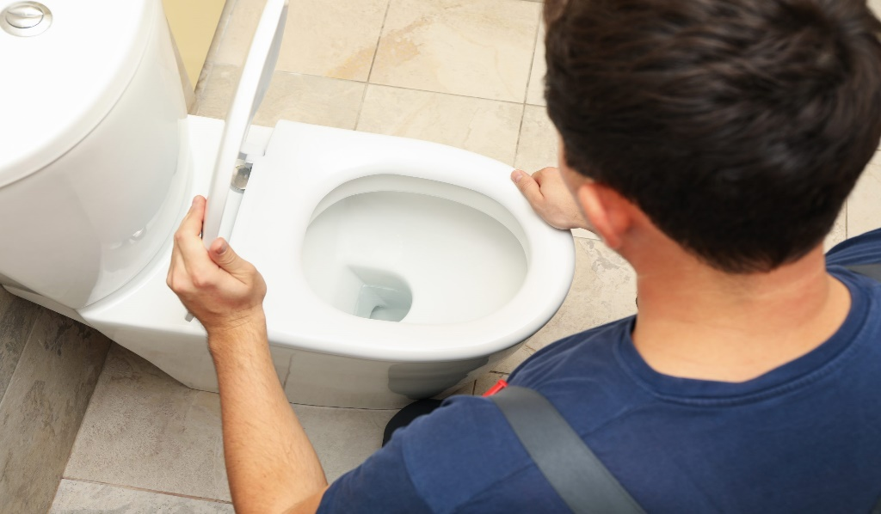
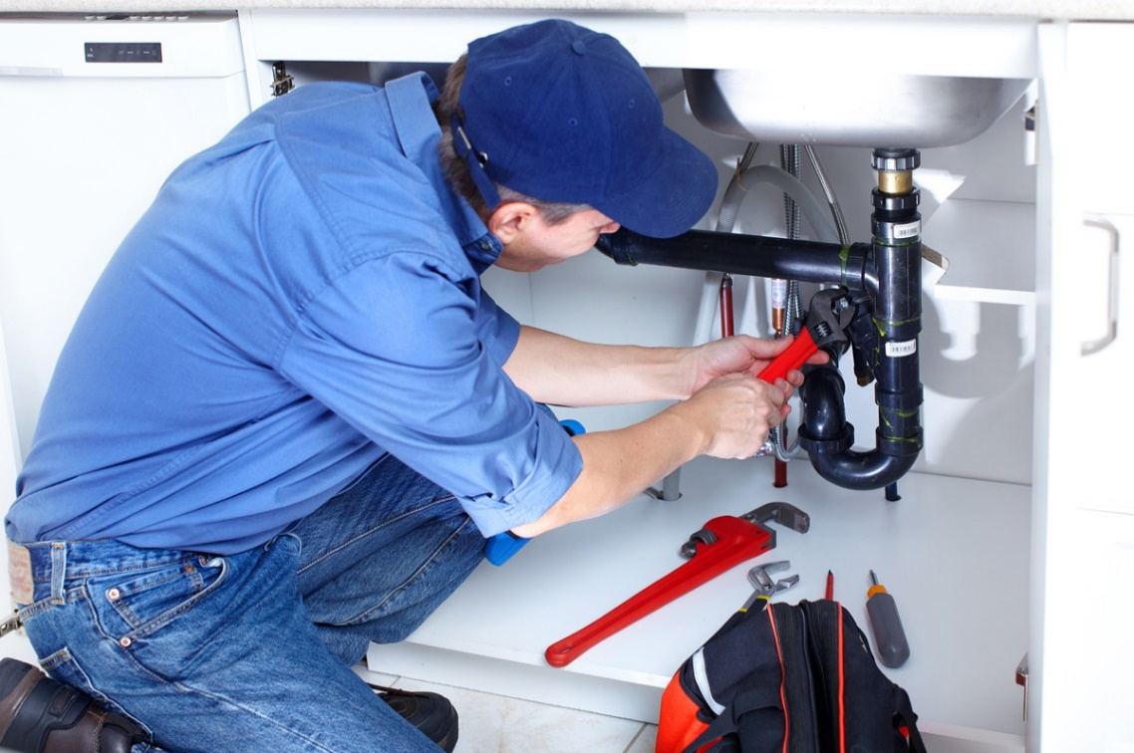
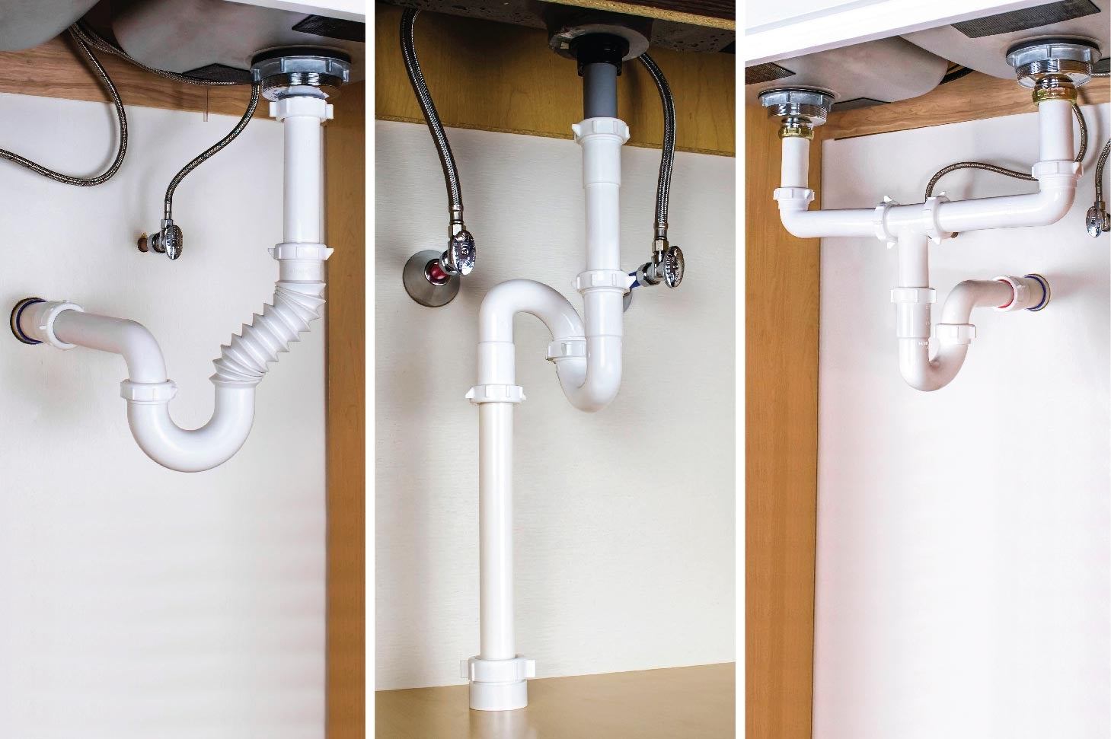
Tricks of the trade
Plumbing

Slide 30
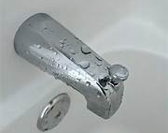
Plumbing
After completing a repair on the main line, rut the tub or a faucet without an aerator to prevent any debris that may be in the line from causing a clog. This will help prevent a call back for low water pressure.

Slide 31

Comedy Plumbing but True
Be strong and resist biting your finger nails, touching your face, or other open wounds of your body. Always wear gloves when working with plumbing and remember to washer your hands thoroughly once finished. This prevents infections in the body and server illness. Although we all enjoy the yummy stuff underneath our finger nails it is not worth the risks.

Slide 32
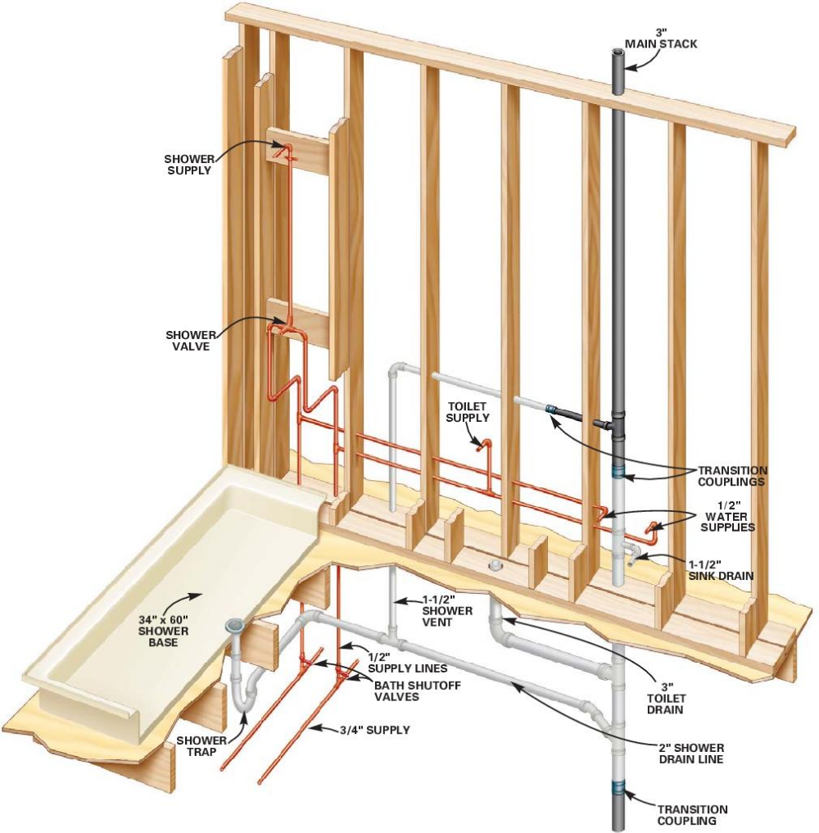
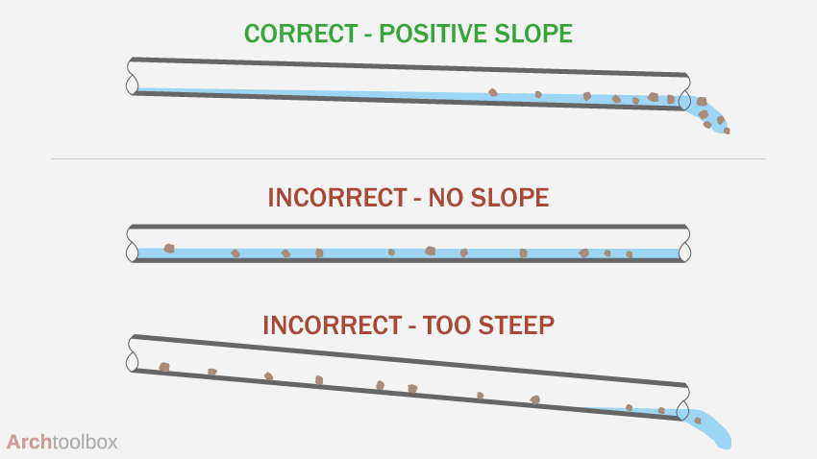
Plumbing
Your slope should ¼’’ per foot on your drain lines.
An incorrect slope in drain pipes can lead to two main problems: slow drainage and standing water, or too rapid drainage that leaves behind solids, potentially leading to clogs. If the slope is too shallow, water will not flow quickly enough, causing it to stagnate and possibly lead to the growth of bacteria and unpleasant odors. On the other hand, if the slope is too steep, water can rush through the pipes, leaving behind debris that could accumulate and cause blockages.

Slide 33
Plumbing
Advise residents to run water and grind ice through the garbage disposal at least once a week to help them from seizing up.
Use a vinegar, Dawn dish soap and baking soda mixture to clean out disposals and drains. Dump it in and let it sit for 10 minutes before rinsing it out.
Check water heater expansion tanks during preventative maintenance for leaks, corrosion, etc. to prevent it from blowing out and causing excessive damage.
Have a snake camera available
Have a quarterly flyer distribution about what not to put down the drains
Replace all the old water faucets
Feel pipe for leaks.
Carry shark bite tools and bring multi tool with you
Water heater – drain from the top with shop vac, use strap to remove, elbow shark bite at top
¼” fall per foot on drain lines
Don’t bite your fingernails
Use plastic lock washers on toilet seat bolts to cut down on calls
Have a map of all shut offs and sewer drops
If active leak, walk the resident through turning off the water immediately

Slide 34
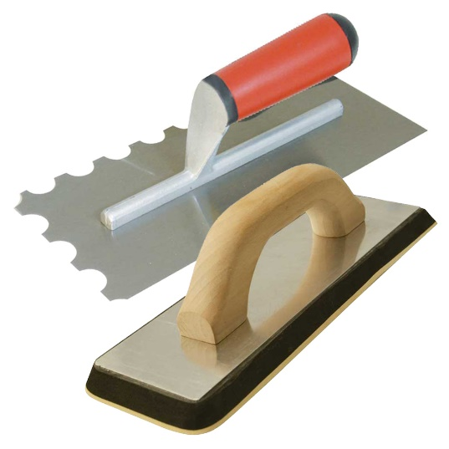



Tricks of the trade
Tile/Backsplash

Slide 35
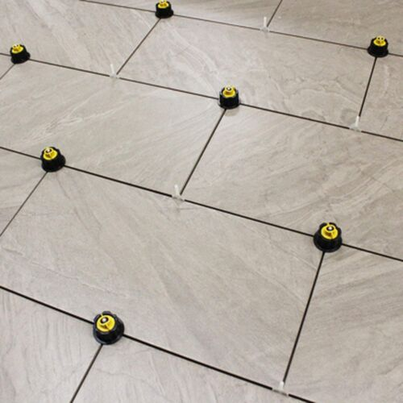
Tile
Using spacers and leveling system while doing tile will give you the beautiful look not only, we are looking for, but the look our residents deserve. Spacers will give the grout line you want and the leveling system will give you a smooth finish.

Slide 36
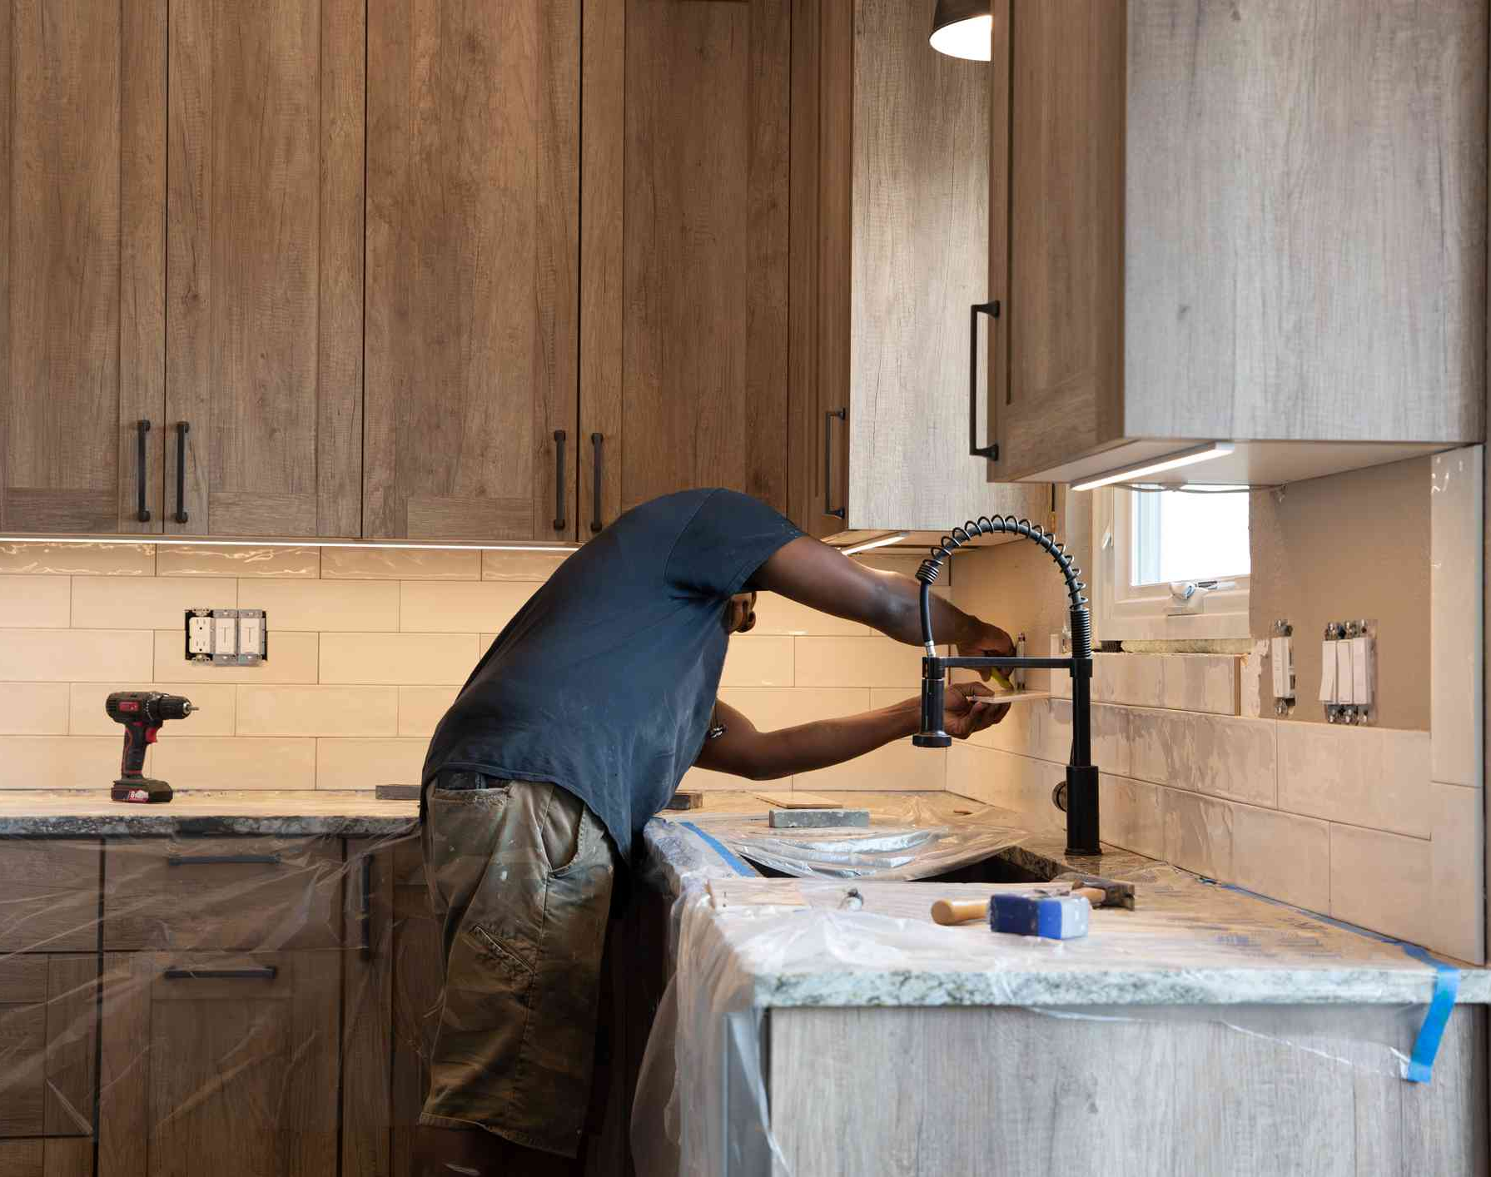
Tile
Make sure your first row of tile is level, from there all should run smooth and quickly from there.

Slide 37
Tile
Using a grinder with a cutting wheel to make tile cutting fast and easy.
Make sure you’re not making mistakes in the cuts as it takes a lot of time
When doing grout, clean most of it but after it drays, the small spots can be wiped away.
Use tile spacers
  Others say don’t use tile spacers?
Know what your layout is and precut tile
Skimcoat wall to make even
Clean grout as you go
Use fingers for grooves and to get into cracks
Start with a level first row
Gapping properly helps
Set rows of tiles, then put spacers in to get more area covered faster
Instead of replacing, you can have tiles painted

Slide 38



Tricks of the trade
Tools

Slide 39
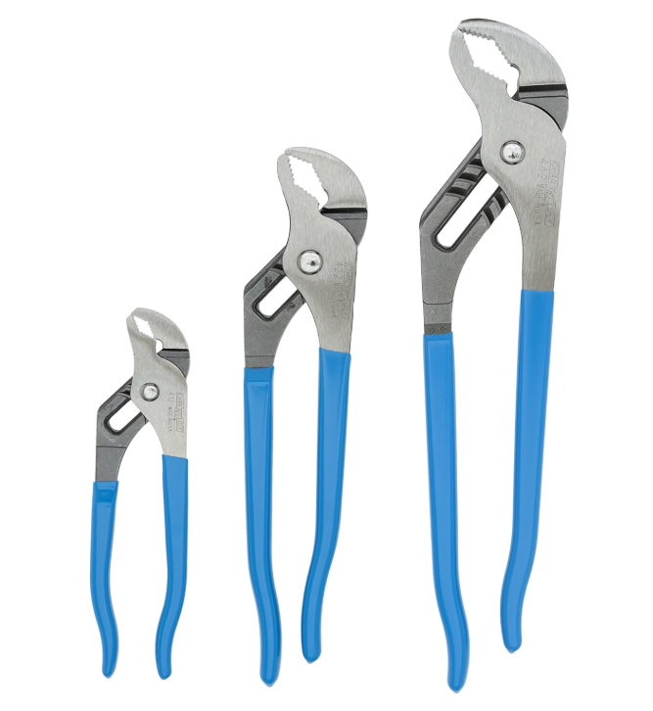

Tools
This is all the tools a maintenance man really needs, isn’t it?
Having the proper tools to make your job easier will allow you to get more done in your day. Always invest in yourself.

Slide 40
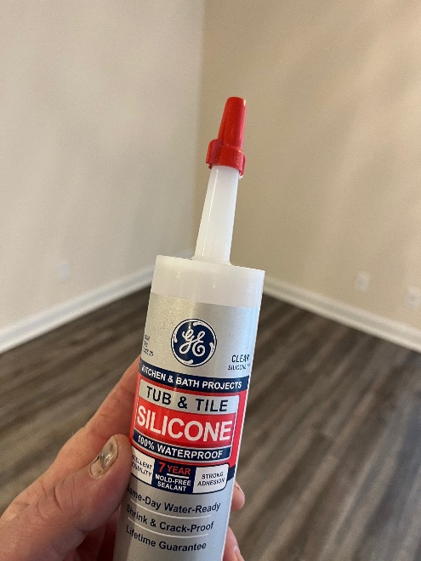
Tools
Keeping your tools organized will allow you to complete your job in a timely manner.
Wire nut caps can also keep your silicone from drying out.

Slide 41
Tools
11 in 1 Klein screwdriver is a great option for an all-in-on tool for most things
Make sure you have the dolphin pool robotic vacuum
Have the right ones and all you need
Tool organizers
Impact, mud bucket and knives, multi tool
Air sled, electric dolly, mail gun, oscillating saw
6” channel lock pliers, razor (?), magic eraser
Have all the tools prepared daily to be successful an deficient with day-to-day operations
Use a wire nut to cap silicone to keep it from hardening inside the tube

Slide 42

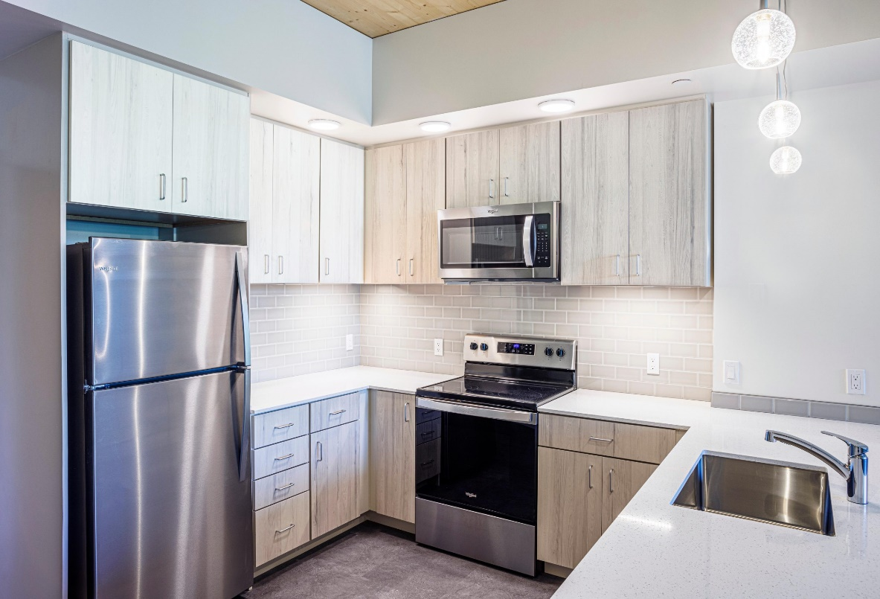
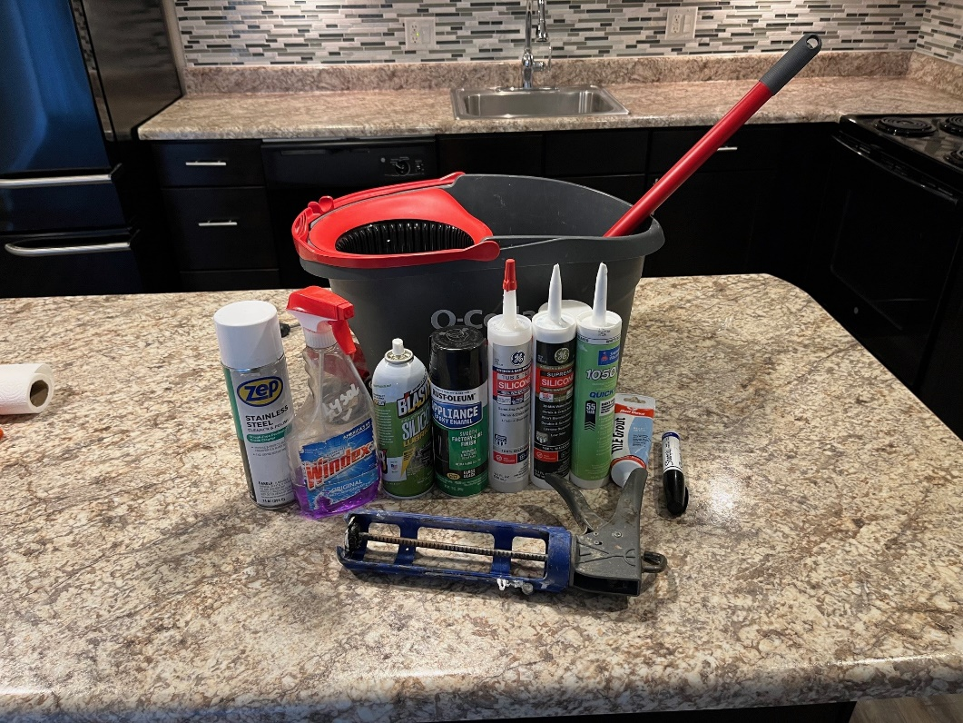
Tricks of the trade
Rehabs

Slide 43
Rehabs
Stay on top of your schedule.
Double check your order list to ensure all supplies have arrived to prevent from getting behind.
Stay organized.
Maintain a clean work space
Collect all the materials first. Make sure all tools and there’s a game plan so there’s not back and forth.
Stay on top of your schedule
Doors – mark each door individually
Toggle belt – fans
Labeling all wires in a junction
Use ledge boards for hanging cabinets
Measure cabinets/countertops 30 days before move-out
Pre-order all materials for your next rehabs and group per apartment
Give your rehab techs a “punch-out bucket” the clean up after themselves when finishing a make ready

Slide 44
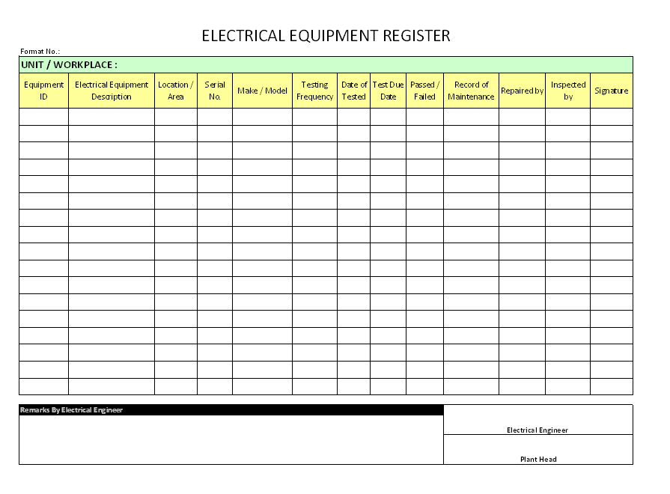
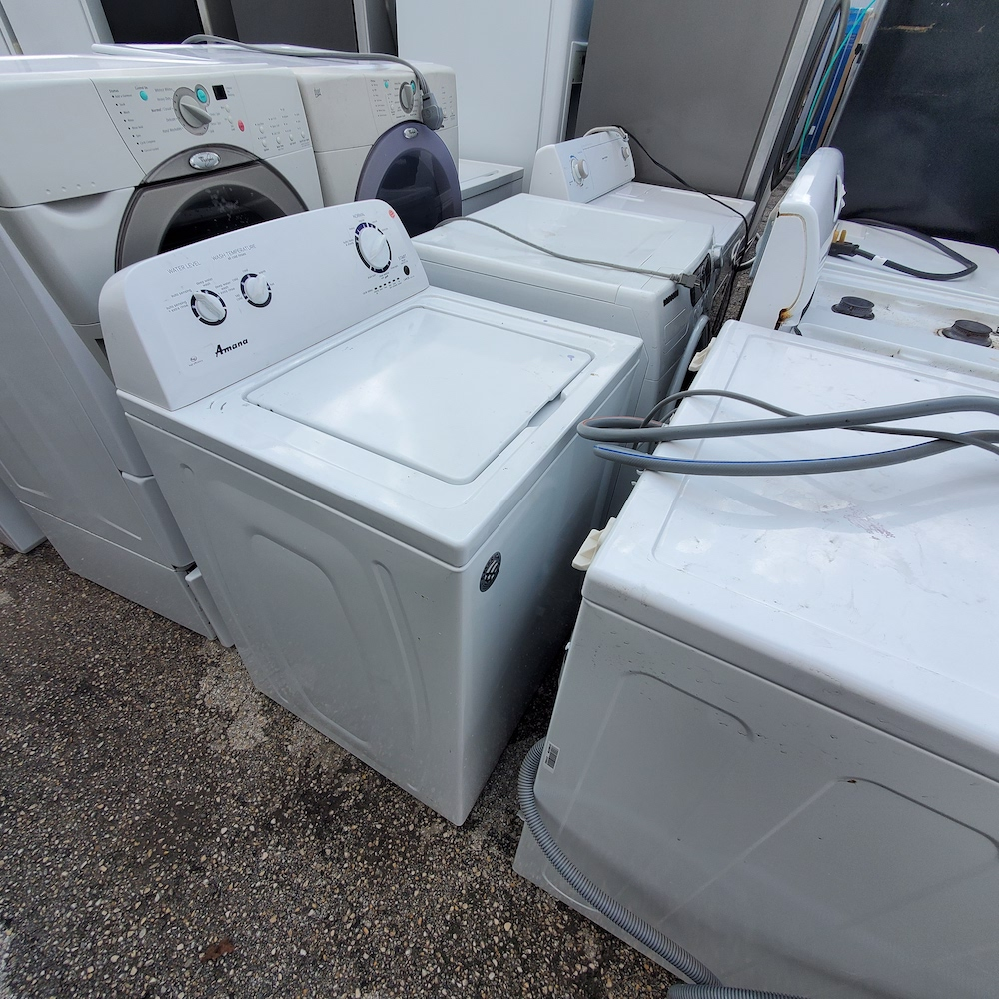
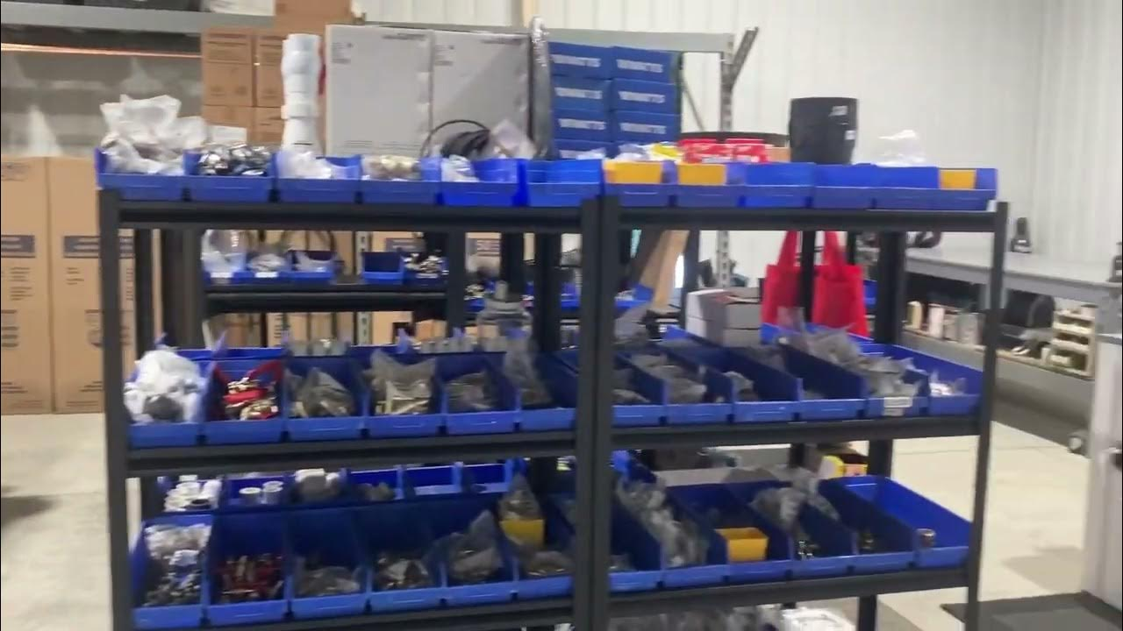
Tricks of the trade
ORDERING/INVENTORY/WALKS

Slide 45
Ordering/Inventory/Walk
Give checklists to cleaners, maintenance, and other vendors to help with quality control.
Check order history to know amount of supplies ordered and if you are over/under ordering in any category.
Do a weekly inventory check to ensure commonly used items are in stock.
Have an “order” sheet available that techs can write down items when they notice them getting low to re-stock before running out.
Keep notes as you go
Use quarterly inspection
Order ahead of time for upcoming turns, projects, inventory, or other items
Labeling all boxes and bins of parts

Slide 46
Ordering/Inventory/Walk
Keep walk sheets and make spreadsheet on computer for budget purposes
Make a standard form for pre-walks to make the process go much faster by just checking boxes instead of writing everything down each time.
Order all needed supplies w/ rep weekly
Complete Michelson inventory report 2x per year, and add/remove items to it as you go instead of waiting for the due dates to complete
Walk all vacants weekly along with scheduling pre-walks for maintenance
Purchase in bulk to save money.
When doing unit inspections, walk along the walls, rather than walking into the middle of the room. It will allow for a more detailed inspection.
If a unit has been sitting for over a month, run water through all the sinks/tubs/washer drain to avoid odor issues.

Slide 47


Tricks of the trade
MISC/OTHER

Slide 48
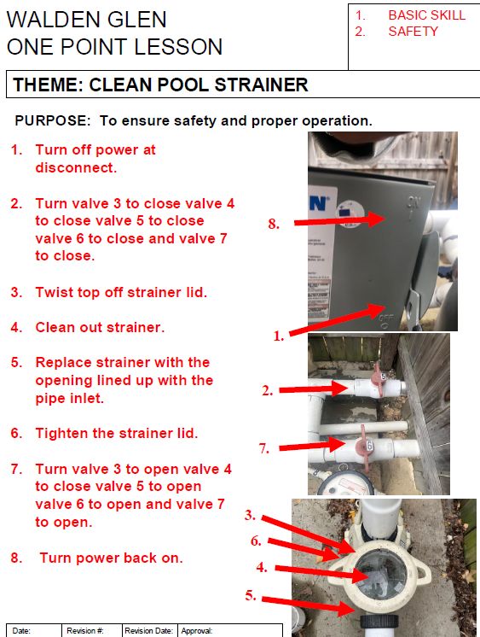
Tricks of the trade
MISC/OTHER

Slide 49
Misc/Other
Be prepared for bad weather.
Always keep your hands busy.
Maintain an organized shop.
Rough or stubborn keys in deadbolts? Rub a pencil on the key for lubrication.
Icy patches? Use a mixture of water, alcohol and Dawn dish soap to melt it.
Eazy drains
If an interior door closes on it own, just pull a couple hinge pins, bend them slightly, and re-install and should stay open.
If you have a door rubbing the jamb on the striker plate side and all of the hinges and hinge screws are tight, you can either remove the hinge pins from 2 hinges and put a shim to make the correct gap with the door shut and then bend then hinge to line up and put the pins back in. Or take a pry bar between the jamb and the door at the point it is rubbing, then pry the door back which bends the hinge also and it should not rub anymore. (SM)
Simple Green degreaser makes removing paint from plank flooring a breeze. Spot spray, wait 5 mins and then wipe with a wet microfiber cloth. https://hdsupplysolutions.com/p/simple-green-20-oz-foaming-crystal-cleaner-degreaser-aerosol-p274857

Slide 50

Q&A
Questions or Comments?
  Open the floor for any questions or further discussion.

